Slide 1
Geopolitics and the maritime sector
Frank Bekkers
Programme Director
New Year's meeting Conoship
January 12, 2024
Notes:
Ladies and gentlemen, in the next 25 minutes I will take you on a journey around the world. We will be in search of major global trends in the arena of international relations that could ultimately have a major impact on your business. Our time scope is some 5-10 years into the future, and possibly beyond. Fasten your seatbelts, it will be a fast and rough journey!

Slide 2
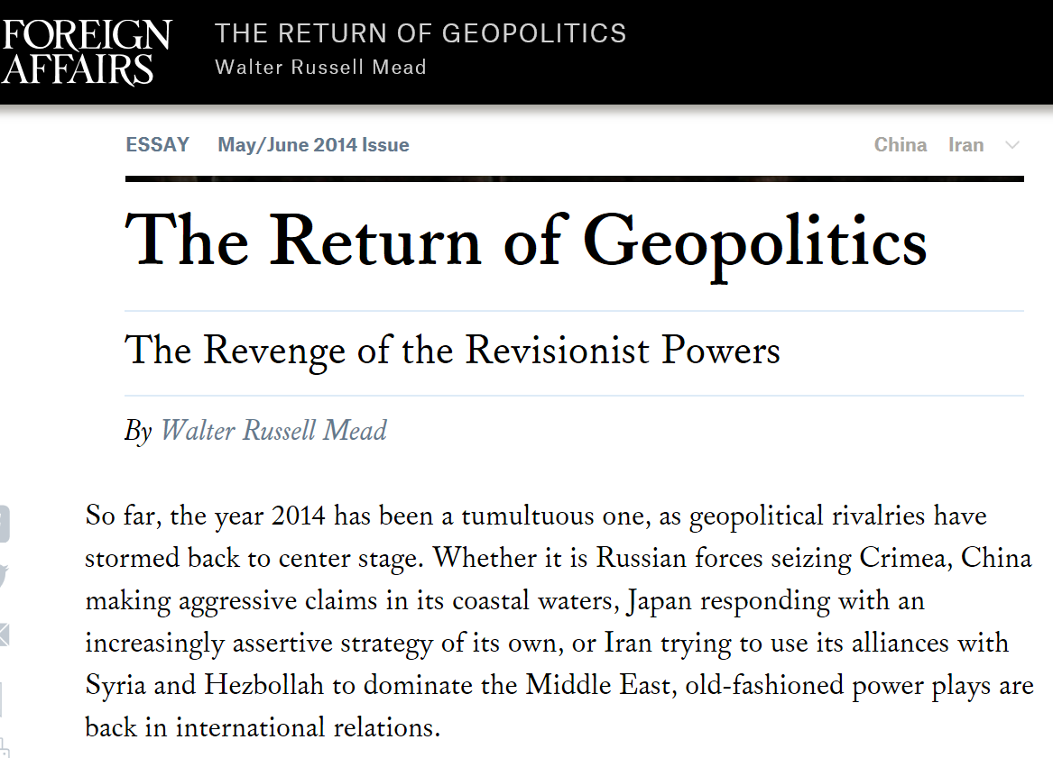
2022:
Ukraine
2014:
Crimea
Google Trends
Notes:
In 2014, the term 'geopolitics' suddenly started to enter the public debate. It was the Russian occupation of Crimea that brought the term to the front. And from February 24, 2022 onwards, with the Russian invasion of Ukraine, even 'ordinary people' were confronted with the concept, as if only because a quadrupling of their energy bill apparently was caused by 'geopolitics'.
We see it in Google Trends: what is trending in Google Search.
We also see it reflected in the presence of our institute in the media. Last year, HCSS was in the national media almost 2000 times (an average of 6 times per day); and that excludes the podcasts of Boekenstijn and De Wijk, which has a weekly audience of almost a million listeners.

Slide 3
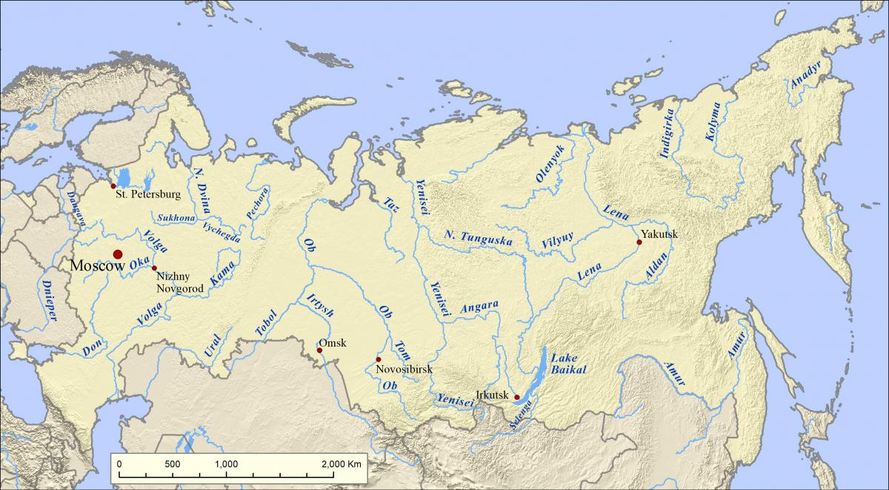
What is geopolitics?
Politics = the way people govern and organize a society. In this case: how countries shape their relationship with other countries
Geo comes from geography. Geographic factors such as location, climate, natural resources, population and physical terrain contribute greatly to the definition of national interests of a nation; the constant factors in foreign policy
Notes:
Because they are based upon factors that remain relatively fixed over time, national interests provide continuity in international relations. This makes it possible to extend past experiences to a certain extent into the future
As an example, Russia’s national security strategy is very much shaped by the fact that its western region is relative flat, with quite open plains all the way up to Moscow. This is where enemy armies have advanced to Moscow several times in history. Napoleon in 1812 and Germany in 1915 and 19421. So Russia is preoccupied with the creation of buffer zones west of Russia. The invasion of Ukraine certainly has to do with that.
It is interesting to see that at the beginning of this century, our idea of the world was shaped by digital connections which recognize no borders or frontiers and JIT trade flows which were convenient, cheap and hassle free. But in the current era, geographical location matters again. Also in the maritime world: for a Dutch shipowner, whether a ship is produced in the Far East or in Europe is again becoming an important factor.

Slide 4
Geopolitical trends that may shape the maritime sector in the coming decade
The influence of great power competition and bloc formation on maritime trade patterns
A maritime counterpart to the scramble for resources!?
Climate mitigation and adaptation
Notes:
In our quick journey, we will look at three major geopolitical trends and what they could mean for the global maritime sector.

Slide 5
Geopolitical trends that may shape the maritime sector in the coming decade
The influence of great power competition and bloc formation on maritime trade patterns
A maritime counterpart to the scramble for resources!?
Climate mitigation and adaptation
Notes:
So lets start with, you’ve guess it, the first one

Slide 6
Notes:
Maritime transport is crucial for international trade and the global economy. Over 50% of the value and 80% of the volume of international trade is carried over sea.

Slide 7
Source: UNCTAD Review of maritime transport 2023
Notes:
In recent decades we have seen an almost continuous growth of seaborne trade, not in the least between the Far East and the major ports on the North Sea; as illustrated by this graph. This is what we call globalization.
But will this year-on-year growth continue? Perhaps not.

Slide 8
Possible drivers for changing maritime trade patterns (de-globalization)
‘De-risking’: diversification of global supply chains, raw material production and economic activities closer to home (friendshoring, nearshoring, reshoring)
Transport costs: for many goods (worldwide) transport may become a significant cost and/or risk item
Security risks: threats of piracy, hijacking and war; especially/certainly in chokepoints. Erosion of freedom of navigation
Notes:
There are various possible developments that could lead to forms of de-globalization. There is still a lot of uncertainty involved in most of them, and, if these developments do indeed continue, it probably will take decades for them to fully materialize. But there are also shocks conceivable that can lead to acceleration.
We will go through these three drivers for potential de-globalization one by one.

Slide 9
Possible drivers for changing maritime trade patterns (de-globalization)
‘De-risking’: diversification of global supply chains, raw material production and economic activities closer to home (friendshoring, nearshoring, reshoring)
Transport costs: for many goods (worldwide) transport may become a significant cost and/or risk item
Security risks: threats of piracy, hijacking and war; especially/certainly in chokepoints. Erosion of freedom of navigation
Notes:
The first driver requires a short introduction.

Slide 10
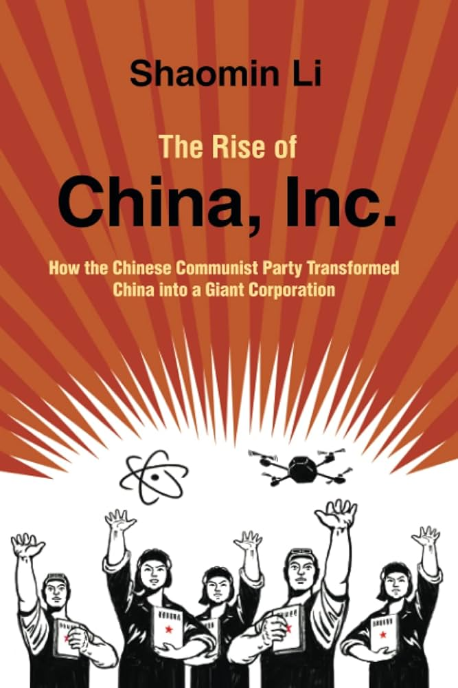
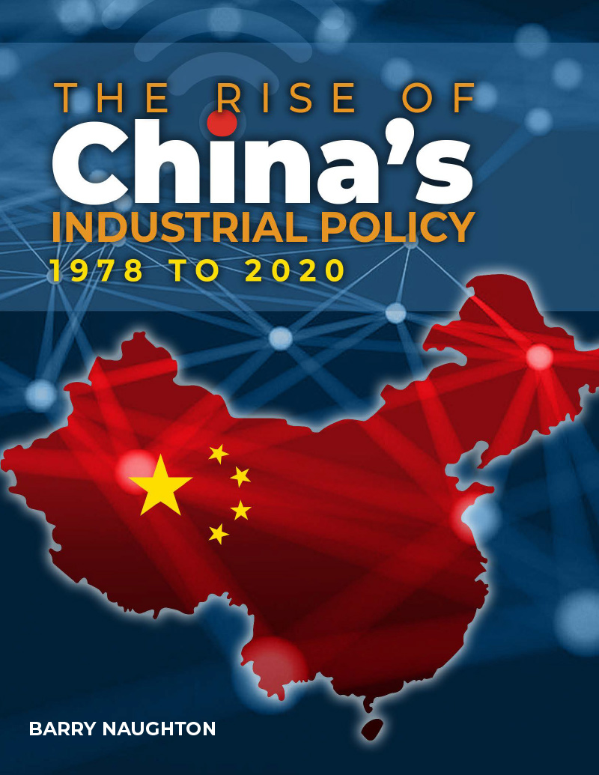
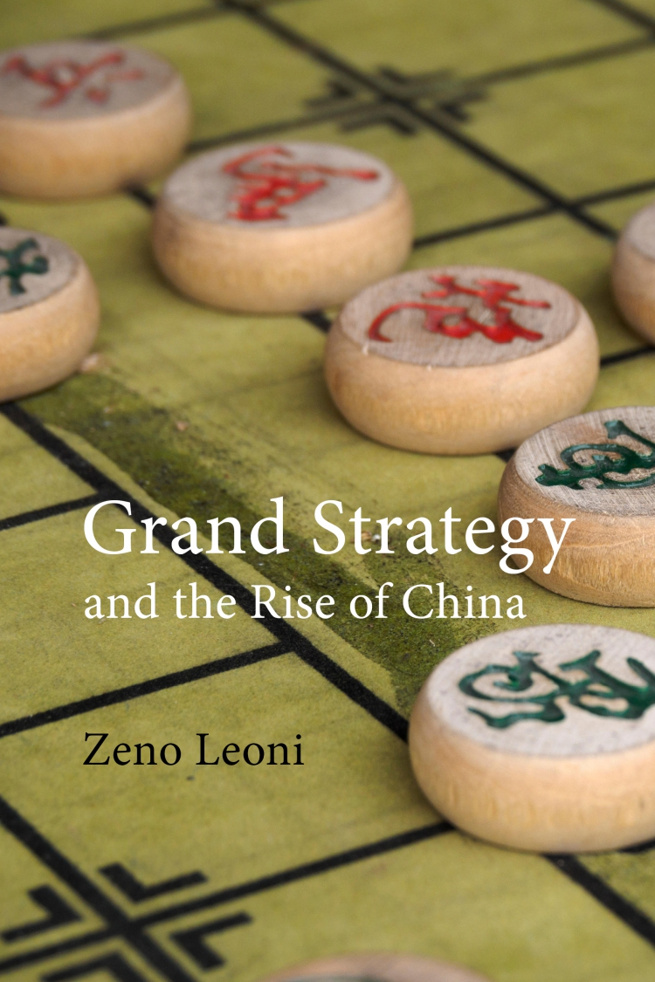
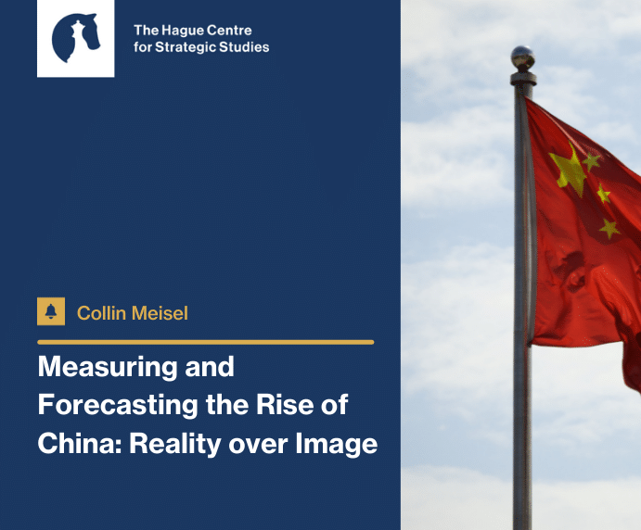
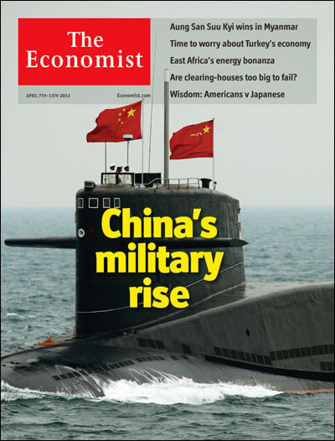
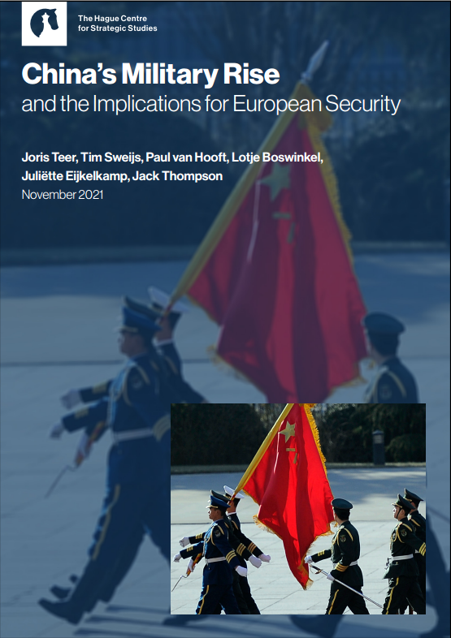
Notes:
THE most salient factor in geopolitics over the past 40 years has been the rise of China, challenging the global hegemon the United States. China's growing power has set in motion a series of dynamics that has upended the multilateral order and brought us a world that is characterized by systemic rivalry between the US and China.

Slide 11
The Harvard Thucydides Project
”It was the rise of Athens and the fear that this instilled in Sparta that made war inevitable”
Notes:
Research by the university of Harvard shows that, historically, the rise of a new power that threatens the dominant position of an existing power does indeed often lead to war. This research is named after the Athenian historian and military general Thucydides who argued in the 5th century BC that war between rising Athens and existing power Sparta was inevitable, not because of offensive actions taken by Athens, but due to Spartan fear of the growth of Athenian power alone. (This is what we now call the Peloponnesian War).
The project looked at similar situations over the past 4 Centuries. Indeed, out of 16 cases, 12 cases led to war.
So the emergence of a new power that challenges the incumbent power thus not inevitably leads to war, as Thucydides holds, but certainly constitutes a considerable risk of armed conflict.

Slide 12
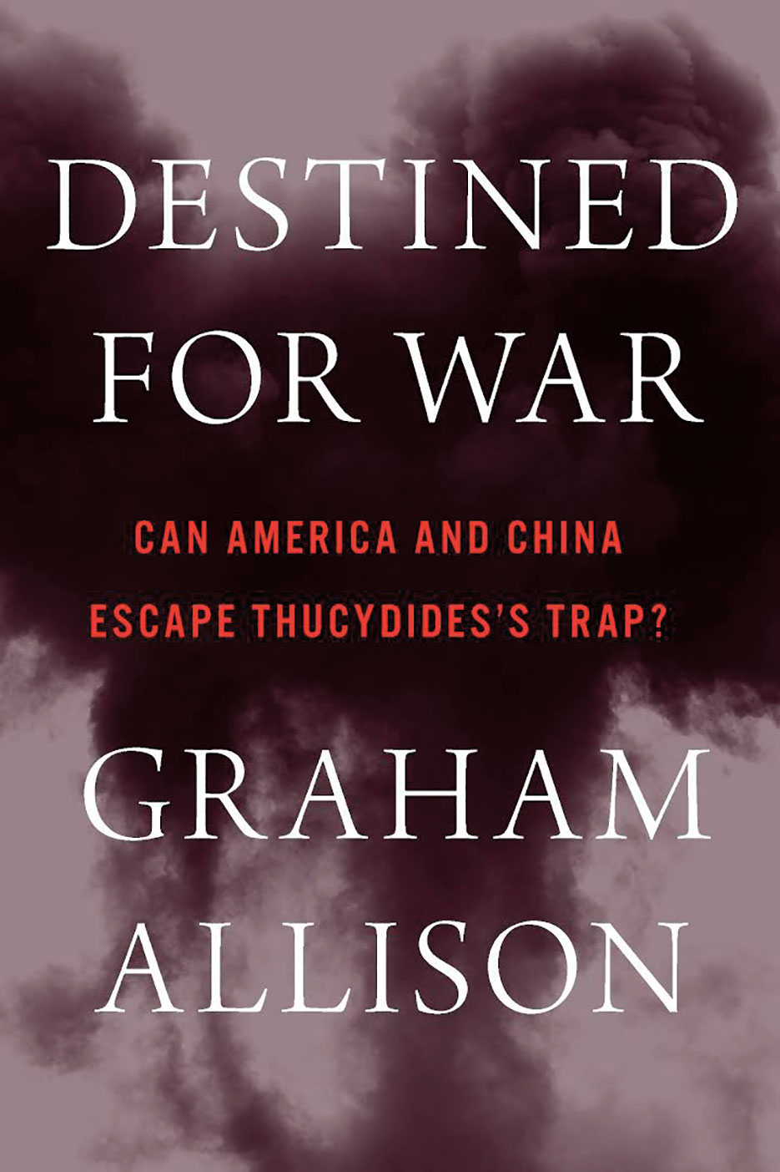
Notes:
So will there be war between the US and China in, say, the next five to ten years? I am not saying that. But it is certainly a real possibility, something to consider as a possible scenario.
Even if an open, large-scale armed conflict does not arise, there are sufficient situations conceivable in which mutual restrictions are imposed on the freedom of navigation in crucial waterways or the antagonism between the West and China causes maritime security problems to be insufficiently addressed. Incidents or more structural disruptions of maritime trade flows are certainly something to consider moving forward.
Some say, the US and China already are engaged in a kind of war, a war that plays out in the cyber domain, in the economic realm, in proxy wars all over the globe.

Slide 13
Possible drivers for changing maritime trade patterns (de-globalization)
‘De-risking’: diversification of global supply chains, raw material production and economic activities closer to home (friendshoring, nearshoring, reshoring)
Transport costs: for many goods (worldwide) transport may become a significant cost and/or risk item
Security risks: threats of piracy, hijacking and war; especially/certainly in chokepoints. Erosion of freedom of navigation
Notes:
In light of the growing tensions between the US and China, with Europe somewhat reluctantly and half-heartedly taking sides with the US, we witness growing protectionism worldwide and forms of decoupling between the economies of China and the US.
First China (early-2010s), then the US (>2017) and now slowly the EU (>2022) look more negatively at the international trade regime and are beginning to try and reduce dependencies on geopolitical rivals. They are increasingly pursuing active industrial policies to maintain/achieve a technological edge, increase access to critical economic inputs and expand domestic production capacity.
The terminology the EU used varies: strategic autonomy, decoupling and recently de-risking. Measures are being applied to so-called strategic sectors; but the number of areas designated as 'strategic' is growing.
It is clear that if reshoring and nearshoring really takes off, global trade patterns can drastically change over time.

Slide 14
Possible drivers for changing maritime trade patterns (de-globalization)
‘De-risking’: diversification of global supply chains, raw material production and economic activities closer to home (friendshoring, nearshoring, reshoring)
Transport costs: for many goods (worldwide) transport may become a significant cost and/or risk item
Security risks: threats of piracy, hijacking and war; especially/certainly in chokepoints. Erosion of freedom of navigation
Notes:
Let us turn to the second possible driver for de-globalisation: transport costs. Fuel, port fees, environmental costs; but also mismatches in supply and demand and major disruptions in the chains. And, of course, to cover risks leads to extra costs

Slide 15
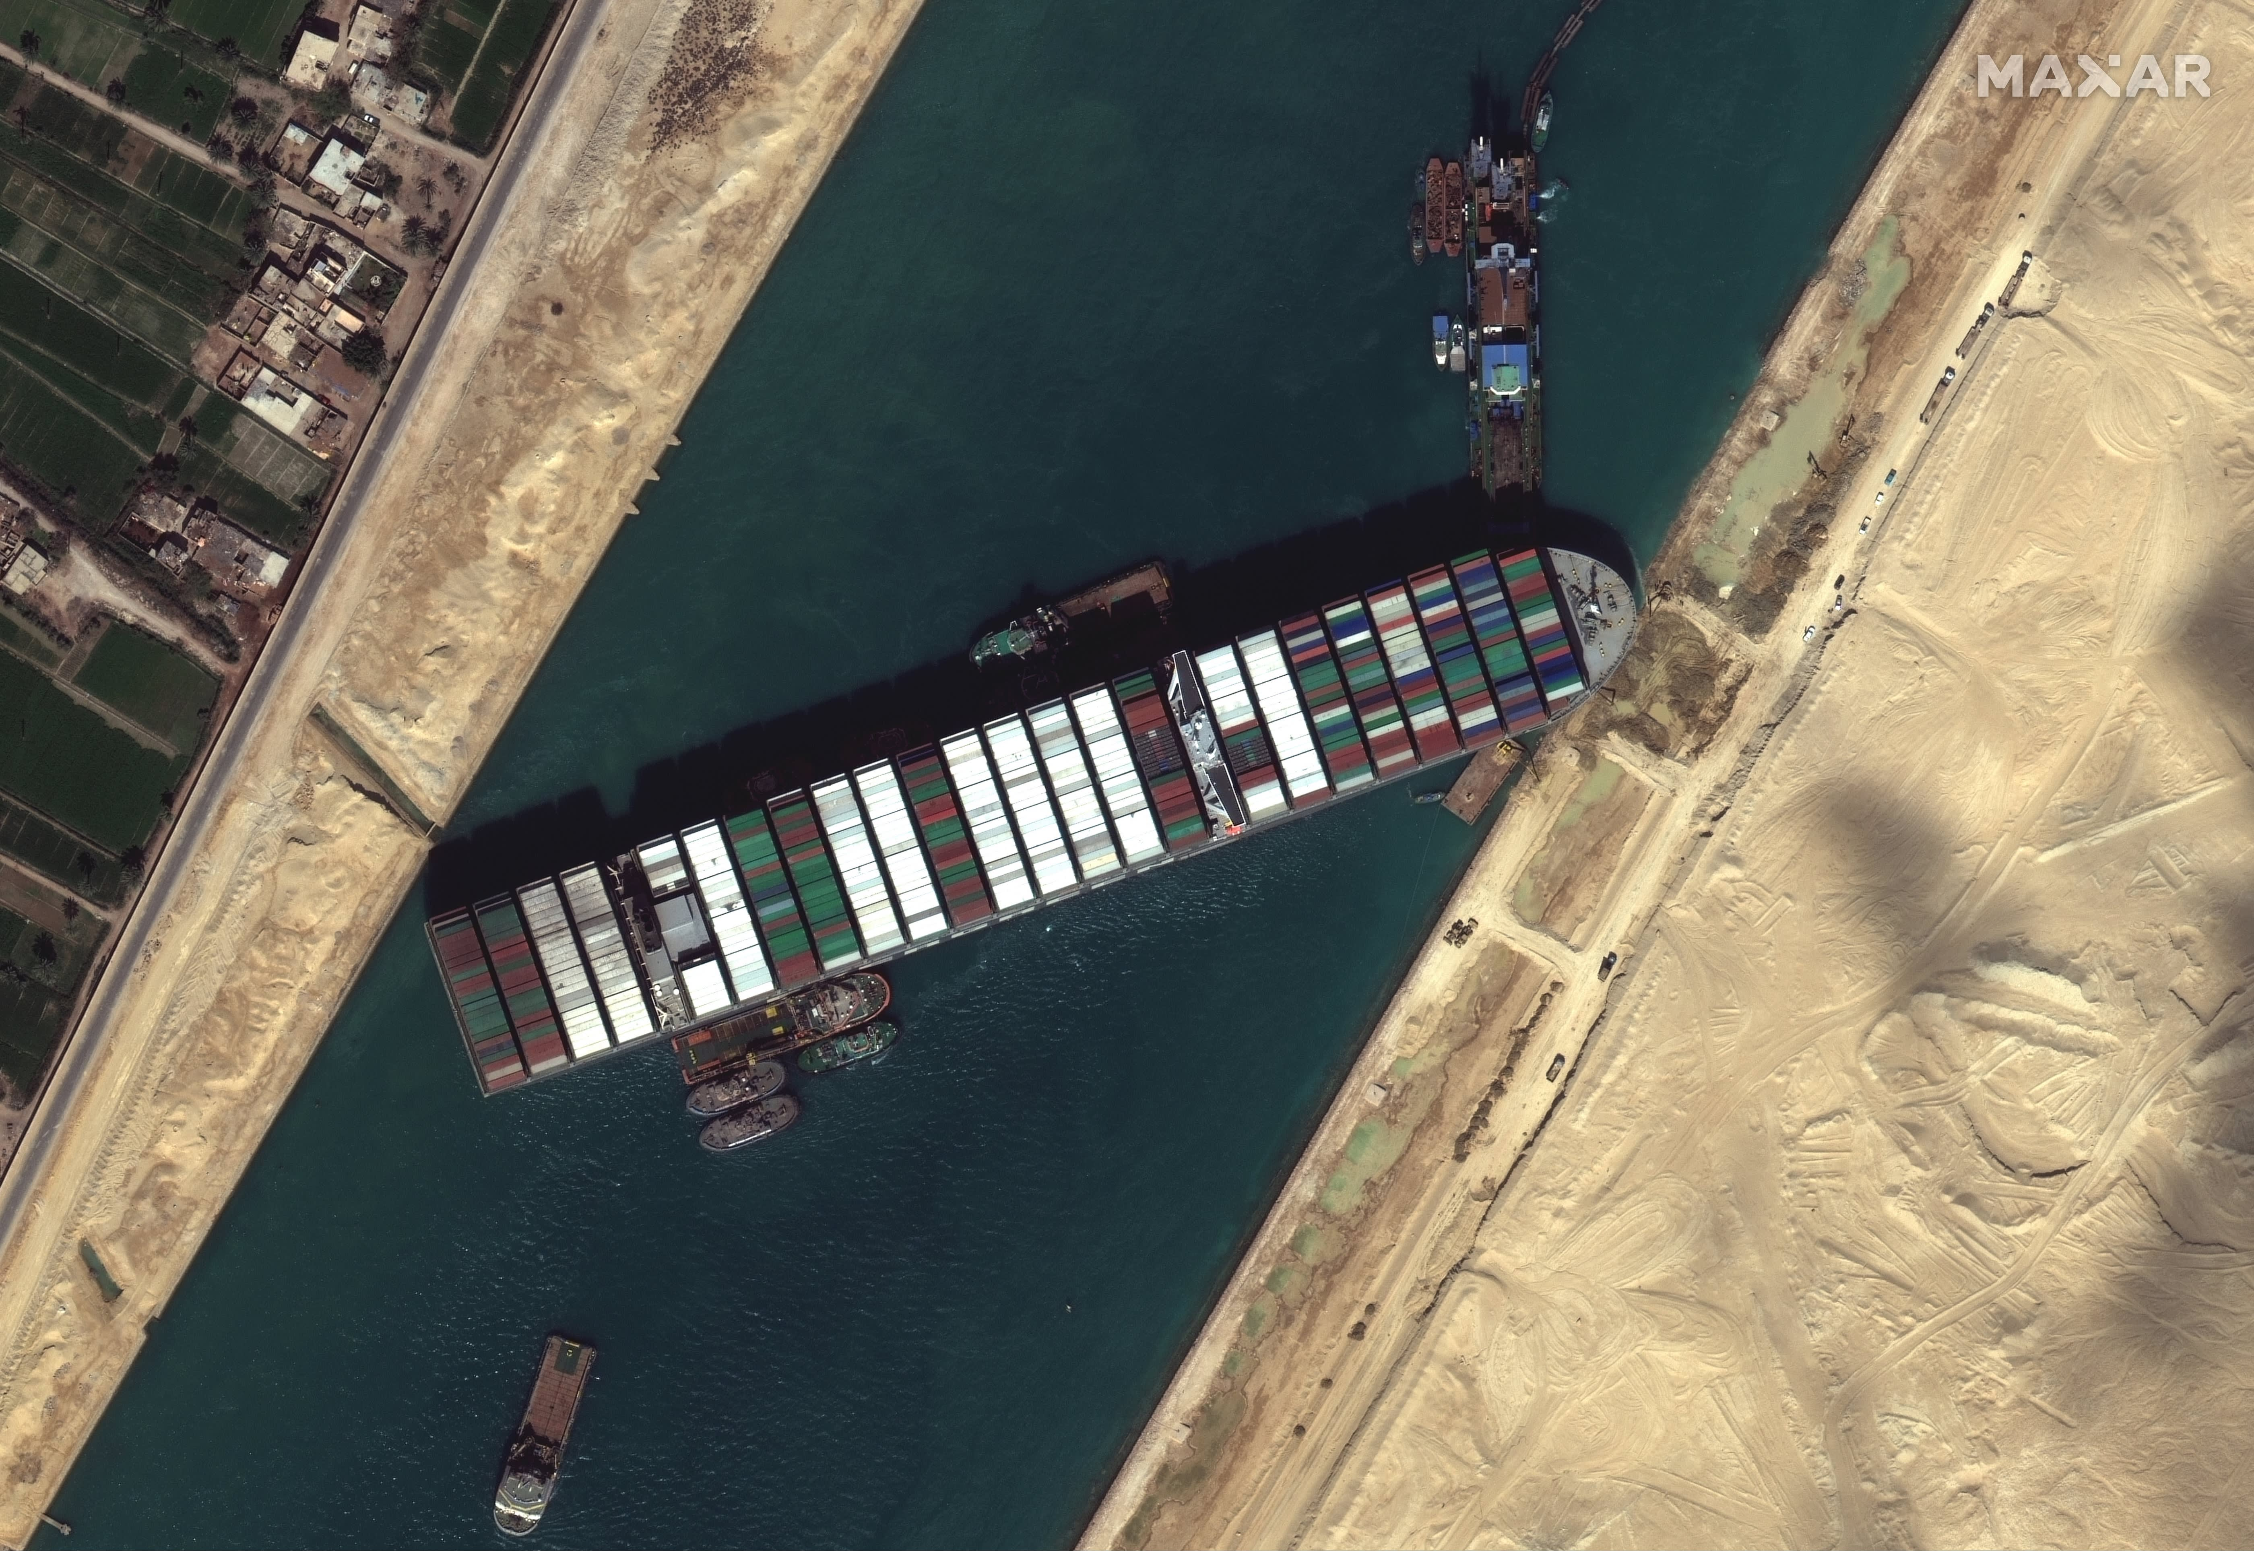
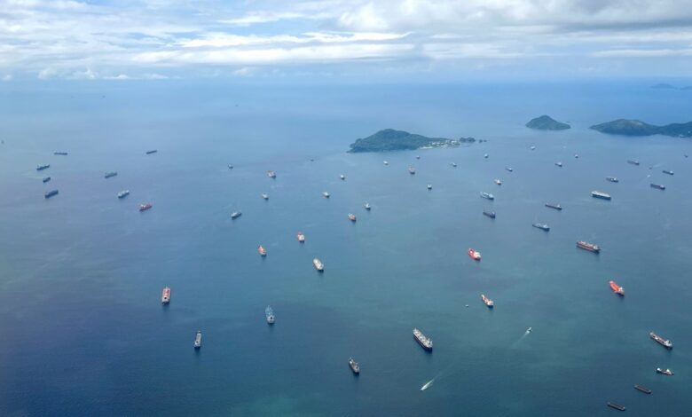
Source: ING
Notes:
For example, in 2021-2022 we saw a huge increase in container and bulk shipping rates. The graph shows the development of port-to-port container freight rates in $ per FEU (40 ft container) from 2020 to mid 2023. This had everything to do with the effects of Covid-19 restrictions, particularly in China.
Covid-19, of course, was a temporary crisis, not a long-term structural thing. But incidents and crises compound. Think of the
Ever Given blocking the Suez Canal; queues for the Panama Canal due to draughts. And the emerging world order seems more prone to incidents and crises than in the past.
Bottom line is that, in general, rising maritime transport costs tend to reverse the globalization trend in international trade and promote more regional and local maritime trade.
(Source: https://www.ing.com/Newsroom/News/Global-container-shipping-outlook-pressure-mounts-amid-flood-of-new-capacity.htm)

Slide 16
Possible drivers for changing maritime trade patterns (de-globalization)
‘De-risking’: diversification of global supply chains, raw material production and economic activities closer to home (friendshoring, nearshoring, reshoring)
Transport costs: for many goods (worldwide) transport may become a significant cost and/or risk item
Security risks: threats of piracy, hijacking and war; especially/certainly in chokepoints. Erosion of freedom of navigation
Notes:
The third driver has to with the erosion of the multilateral order and the proliferation of conflict across the world.

Slide 17
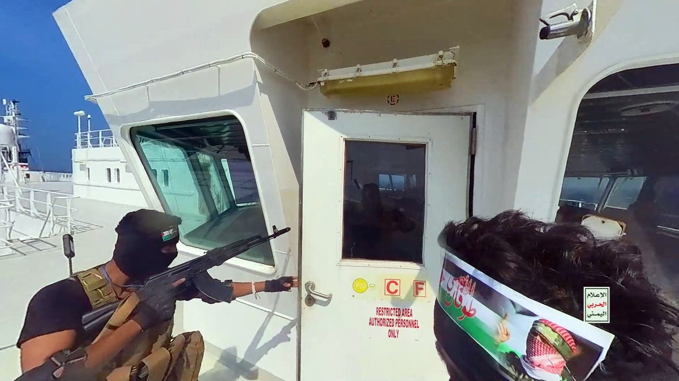
Notes:
You probably remember the recent images of Houthis taking over ships in the Red Sea. Piracy, of course, is of all times. Over the past decades, for example, we have witnessed a surge of piracy and hostage taking in the Gulf of Aden. But these risks only seem to be increasing in the contemporary world of great power rivalry.
One of the major developments that lies at the heart of this, is that intrastate conflicts become increasingly internationalized. Rival countries support opposing factions in internal conflicts, which thereby escalates from a local to an international scale.

Slide 18
Notes:
But it is not just non-state actors – such as warring factions in an internationalized conflict such as in Yemen - that may attack ships to send clear signals. States with regional ambitions can also pose a threat to freedom of navigation and safe passage. Iran is a clear point in case.
And as the subtitle of this recent article reads: “longer and costlier shipping route are therefore becoming the norm”

Slide 19
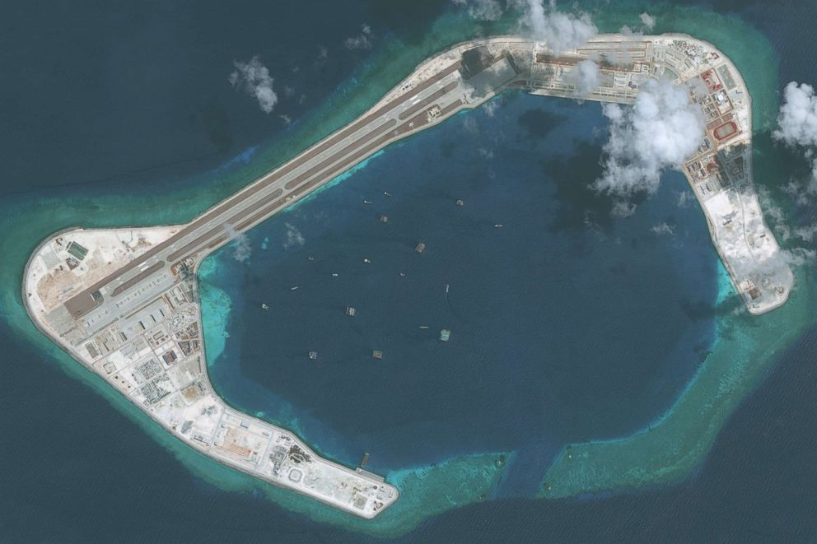
Notes:
Another concern for international maritime trade is that China could restrict – and has forcefully restricted - freedom of navigation through excessive territorial claims around artificially created islands in the East and South China Sea. In 2013, the Philippines initiated legal proceedings against China about this. In 2016, the Permanent Court of Arbitration in The Hague ruled that China's historic claims to the South China Sea were invalid. However, China openly rejected this statement and continued to expand and militarize areas in the South China Sea.

Slide 20
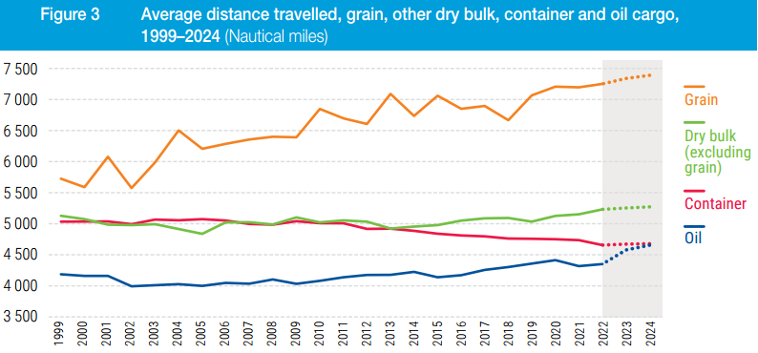
A number of triggers for a possible decrease in deep sea trade; is this visible in the numbers?
Source: UNCTAD Review of maritime transport 2023
Notes:
Each of these three drivers, and certainly in combination, may lead to a decline in deep sea trade. This, morte likely than not, may well benefit short sea shipping.
Is this already visible in the data, for example in the average distance for which goods are transported by sea? It seems not, or better: not yet. But we may be at the beginning of a series of developments that only slowly change the global maritime patterns; or potentially somewhat faster, if a series of 'incidents’ or crises lead to certain thresholds being exceeded, thereby causing acceleration of the trends discussed.

Slide 21
Geopolitical trends that may shape the maritime sector in the coming decade
The influence of great power competition and bloc formation on maritime trade patterns
A maritime counterpart to the scramble for resources!?
Climate mitigation and adaptation
Notes:
The two other developments I will discuss in somewhat less detail.

Slide 22
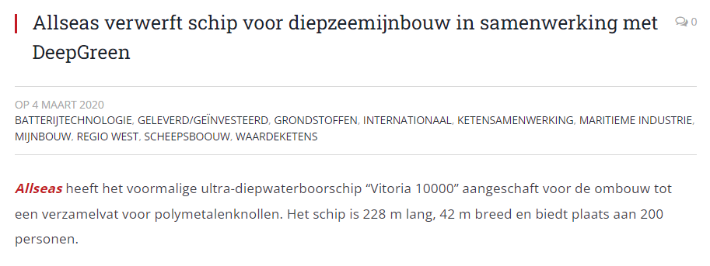
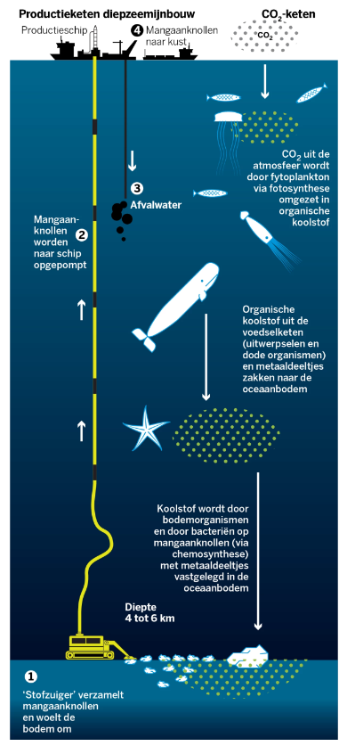
Notes:
Deep-sea mining is a potentially new industry that does not actually exist yet. Although exploratory drilling is currently taking place, commercial deep-sea mining is not yet permitted under international law. The International Seabed Authority (ISA) has awarded 31 'exploration agreements'. These cover more than 1.5 million km² – an area four times the size of Germany.
Norway recently announced extensive plans for research. But it is not a run race. Opponents have three main arguments: (1) expensive and unnecessary; (2) possible major environmental damage (we just don't know); (3) it may cause additional international tensions if a scramble for deep sea resources emerges; as the next graph illustrates

Slide 23
Notes:
Still, I think that deep sea mining in some form will take off in the coming decade. It fits with Europe’s and other states and blocs quest for greater strategic autonomy and efforts to reduce dependencies on systemic rivals on the world stage.

Slide 24
Geopolitical trends that may shape the maritime sector in the coming decade
The influence of great power competition and bloc formation on maritime trade patterns
A maritime counterpart to the scramble for resources!?
Climate mitigation and adaptation
Notes:
Turning to the final trend: the way in which international actors, sometimes in unity, sometimes each on their own, try to tackle the climate crisis that threatens us all.

Slide 25
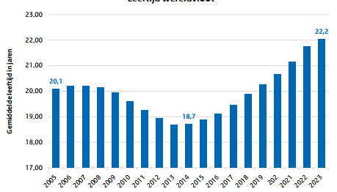
Climate mitigation: limit the global average temperature increase
COP28 approved a roadmap for “transitioning away from fossil fuels”. Shipping must also become more sustainable.
In combination with an aging fleet, it is likely that there will be a high demand for new ships based on ‘net zero’-technologies.
Source: UNCTAD Review of maritime transport 2023
Notes:
Maybe the most salient result of the recent Climate Top COP28 in the UAE is that parties agreed that the world should move away from fossil fuels. This likely means that ongoing initiatives to reduce ship emissions will continue. As other transport sectors, shipping must become more sustainable.
It is likely that this trend will cause a surge in both retrofit and new build of ships over the next decade. This is further compounded by the fact that the global fleet is aging. It might be that the market for retrofit is hampered by the fact that more than half of the deep sea ships is over fifteen years old and impossible or too costly to adapt to new emission norms and standards
A similar and possibly even more pronounced picture applies to short sea ships. About half of that fleet is older than 20 years. About a quarter will reach the end of their economic life (25 years) in the next 5 – 10 years and will therefore need to be replaced.

Slide 26
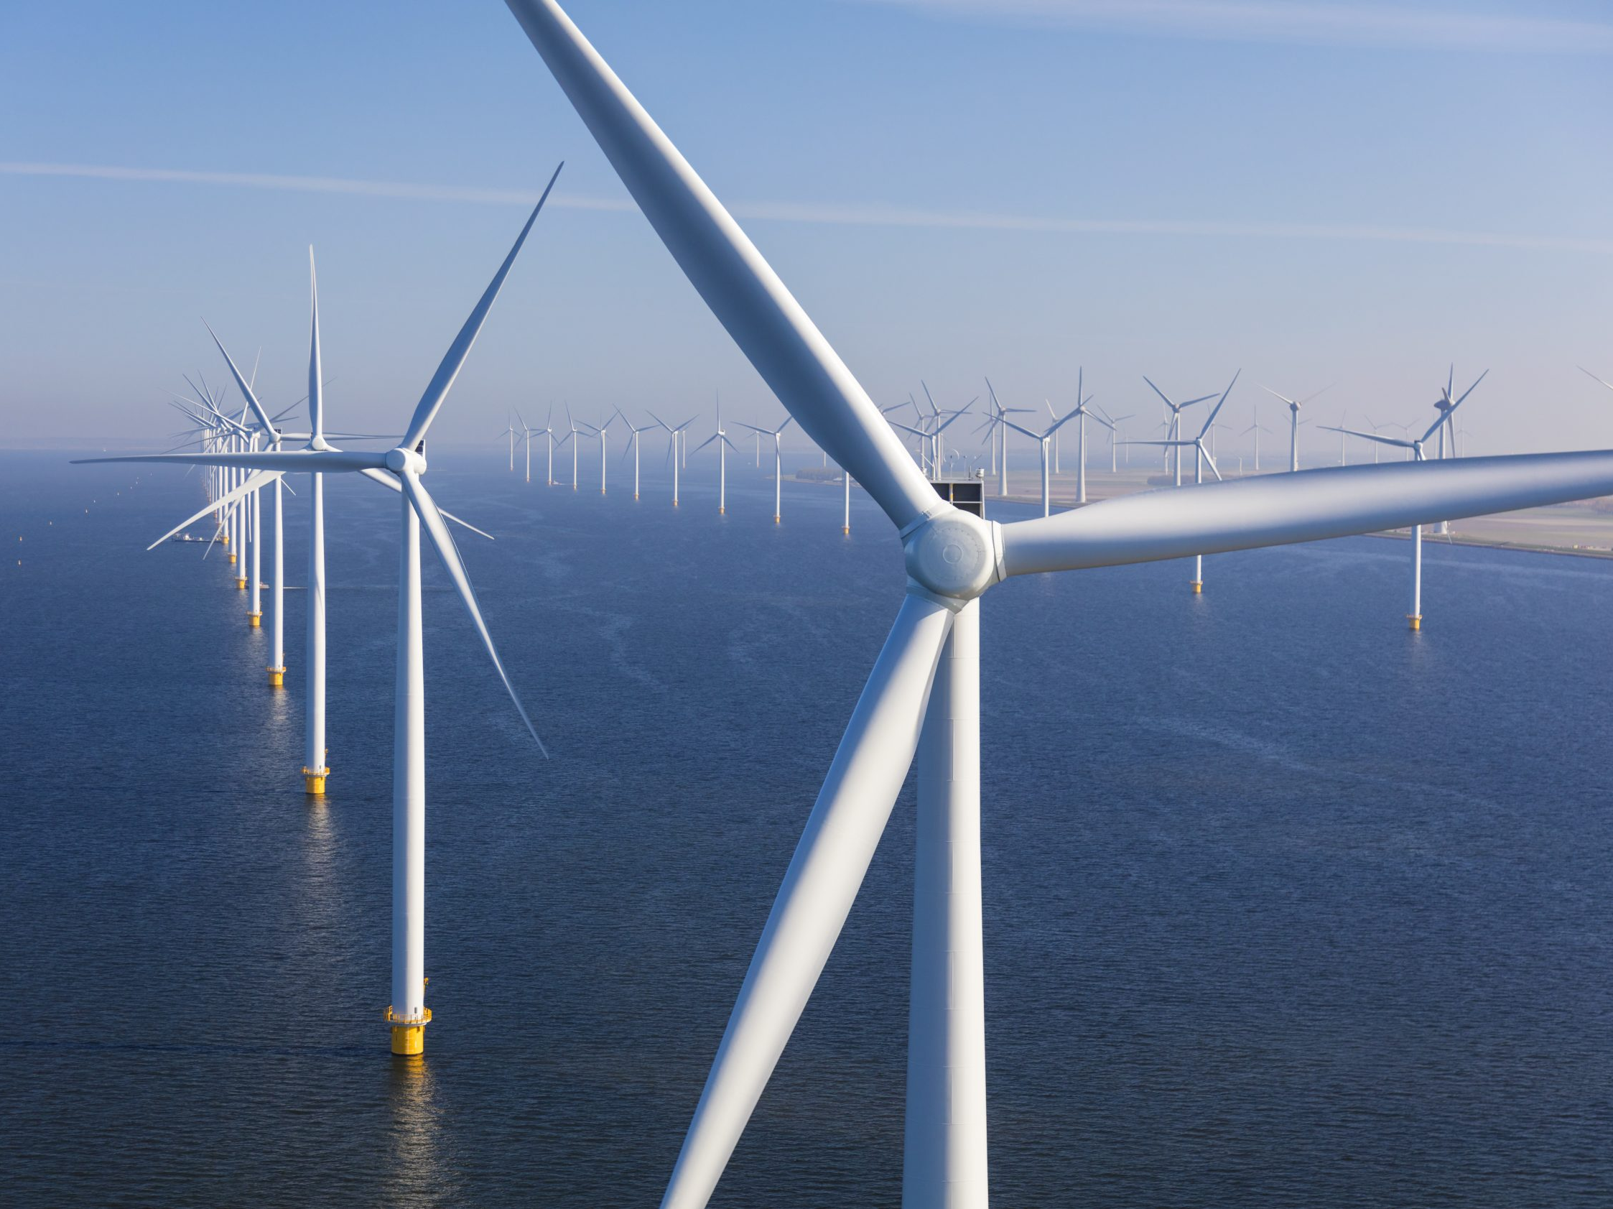
Notes:
Climate mitigation has also triggered the energy transition. As you know, for the North Sea countries, electricity will increasingly come from offshore wind parks. In the next two decades or so, thousands of wind turbines will be constructed in the Dutch part of the North Sea alone.
So, slowly replacing huge oil tankers navigating the global waterways, we will see a surge of small and large utility vessels for the construction and maintenance of offshore wind parks close to densely populated coastal areas.

Slide 27
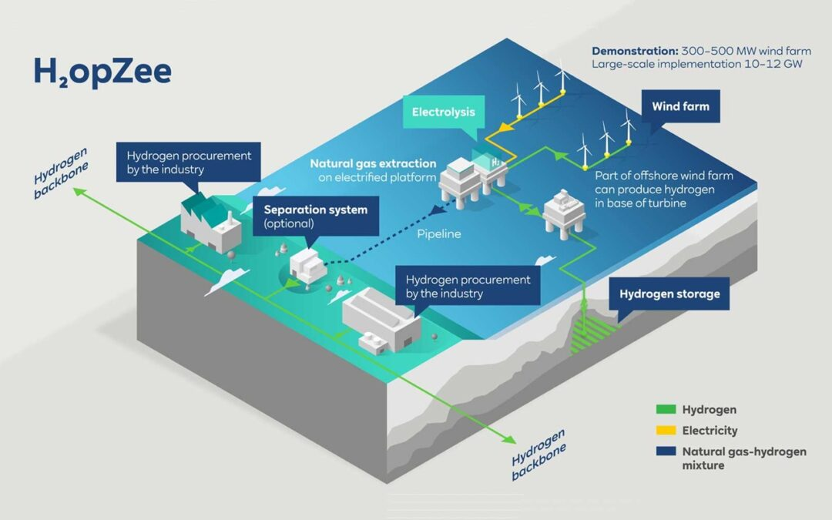
Notes:
In contrast, the market for green hydrogen produced at sea, using the electricity from wind parks, is much more uncertain.
What you see here is a picture I stole from the H2opZee consortium, consisting of RWE and Neptune Energy. The consortium aims to develop a green hydrogen project in the North Sea before 2030.
So, in less than a decade, transport of energy in the shape of oil and LNG may begin to be replaced by H2 transport. At what scale is still a huge unknown. The same goes for the question to what extent a global market for H2 will emerge – with big ammonia tankers in which the hydrogen is stored as an alternative to oil tankers - or whether it is mainly local and regional green hydrogen production that is partly transported by pipeline and partly by ship.
So many uncertainties, but certainly a potential shipbuilding market.

Slide 28
Climate adaptation: adapting to the consequences of climate change
In the coming years there will likely be a shift in focus and investments from climate mitigation to climate adaptation. Rich countries may finance adaptation measures in poorer countries (which are more affected by climate change); partly to 'bind' those countries.
Dutch companies can play an important role in implementing adaptation measures in deltas worldwide.
Notes:
Climate mitigation requires collective action at a global scale. In a world of great power competition, this is less easy to achieve. So attention is likely to shift more to climate adaptation. Adaptation measures are created locally and have their effects locally.
Rich countries, for instance from Europe, may finance adaptation in poorer countries – which across the board are more affected by climate change. This will more and more be a form of aid to 'bind' those countries close to our Western blocs and coalitions.
Based on their broad experience, Dutch companies can play an important role in implementing adaptation measures in deltas worldwide.

Slide 29
Sector Agenda for the Dutch Maritime Manufacturing Industry (MMI)
Notes:
We have been on a short trip around the world, and are now about to safely return back home, in the Netherlands. Let us spend the final few minutes of this tour taking a national perspective. As you all know, last October, special envoy Marja van Bijsterveld has presented the Sector Agenda for the Dutch Maritime Manufacturing Industry.
This was quite a historic event. Prompted by geopolitical developments, and quite contrary to the past decades of neo-liberalism, the Dutch government now wants to pursue an active industry policy. This is industry policy 2.0: not primarily aimed at maintaining employment, as was the case in the 1970ies, but to safeguard our strategic national interests.

Slide 30
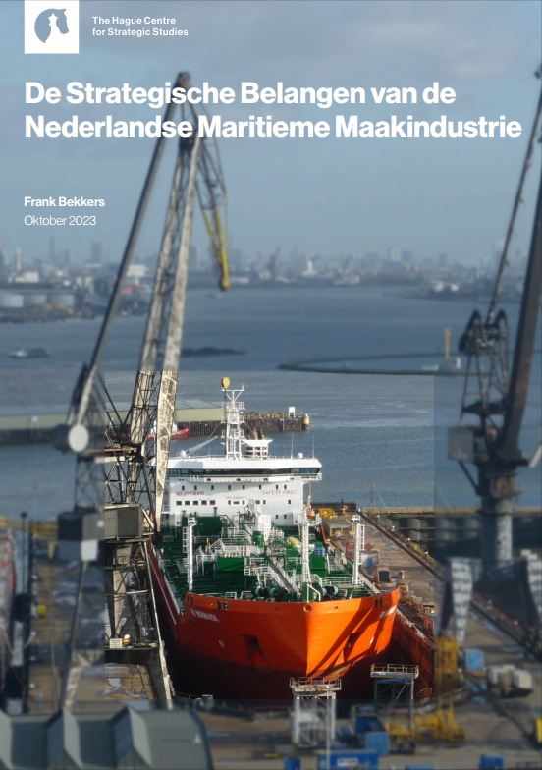
Putting the strategic importance of MMI on solid footing
Notes:
Indeed, the Sector Agenda has the strategic importance of the MMI firmly rooted in the vital national interests of the Kingdom of the Netherlands. For this, the Sector Agenda refers extensively to a report written by Yours Truly.

Slide 31
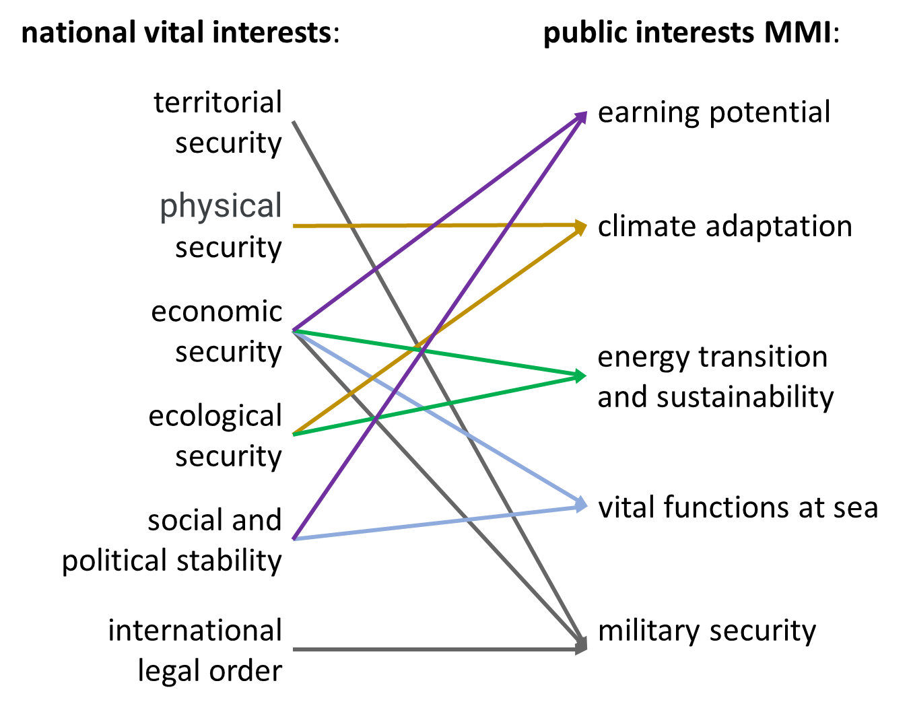
Strategic value of MMI linked to the National Security Strategy
Notes:
In this report, and subsequently in the Sector Agenda, five areas of public interest have been earmarked where the Dutch MMI can, and even should, play a crucial role. These five areas are closely linked to the six national vital interests as defined in the National Security Strategy of the Kingdom of the Netherlands.

Slide 32
Notes:
These five areas of public interest all require various types of ship which for a substantial part should preferably be produced in the Netherlands or through international industrial innovation and production networks with a clear Dutch participation.

Slide 33
Notes:
The Sector Agenda recognizes that a strong national Maritime Sector, firmly embedded in wider European partnerships, requires government support in several areas. I won’t elaborate on this, but if you are quick and have good eyes, you can just about read them on this slide. For everybody else, I refer to the Sector Agenda.

Slide 34
Unique Selling Point in national maritime ecosystem / value chain
Notes:
The government may facilitate but is no entrepreneur. It is the Sector itself that must do the heavy lifting.
The Sector Agenda underlines the importance of the Dutch maritime ecosystem in which all elements are represented from the initial design of a ship to the end users of that ship and the feedback cycles this enables. In a vital maritime ecosystem all links in the value chain should remain vital. This can only be realized through intensive collaboration. Horizontally between similar companies, warfs for instance, in a healthy mix of competition and partnership; and vertically with all elements in the value chain, including the sector-specific educational and knowledge institutes that generate the work force and the innovative technology that is so crucial for the sector.
That ecosystem cannot remain confined to the Netherlands. Cooperation with like-minded countries, in practice often in the north of Europe, is necessary.

Slide 35
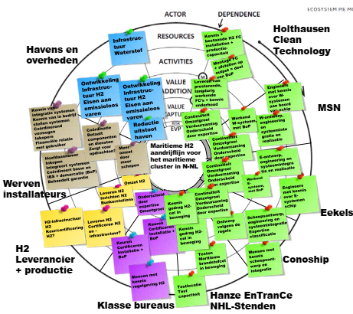
← Ecosystem electric shipping
Ecosystem H2 fuel cells →
Notes:
It is encouraging to see that this open ecosystem approach is fully alive and kicking here in the northern maritime cluster.

Slide 36
Notes:
To conclude, let us close the circle and return to the world of geopolitics. While the 19th and 20th centuries were dominated by the Atlantic region (Europe and North America), the 21st century is referred to as the century of the Indo-Pacific. This is how China visualizes the world.
In that new age of the Indo-Pacific, Europe runs the risk of being marginalized somewhere in the outer periphery. It is important to recognize that, acknowledge it and do something about it. This is certainly the case for the maritime sector. It is truly remarkable that the Maritime Manufacturing Industry is the first sector for which the government has elaborated its industry policy 2.0.
It is very clear that the most important challenges stemming from the Sector Agenda lie with you, the institutes and companies in the sector itself. Facing these challenges will not be easy because the global competition is fierce. At the same time, there are major trends and developments in the emerging world that offer new possibilities; as I hope to have given you a glimpse of over the past 25 minutes. Let me conclude by wishing you every success in exploring and exploiting these possibilities; in the coming year, and for many years to come. Wishing you all a wonderful 2024!

